Slide 1


Slide 2
What is Scala
Scala is a modern multi -paradigm programming language designed to express common programming patterns in a concise ,elegant ,and type-safe way (compiler will validate types while compiling)
The name Scala is the abbreviation of the term scalable language
Martin Odersky and his group created the language in 2003 to provide a high performance & concurrent- ready environment.
It smoothly integrates features of object –oriented and functional languages

Slide 3
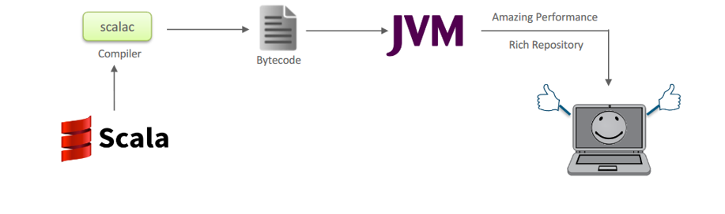
Why Scala
Developers wanted more flexible languages to improve their productivity
The result in evolution of scripting languages like Python ,Ruby ,etc.

Slide 4
Why Scala was preferred for Spark ?
Scala programming retains a perfect balance between productivity and performance
Scala has excellent built-in concurrency support and libraries which make it easy for developers to build a truly scalable application
A single complex line of codes in Scala can replace up to 20 to 25 lines of complex java code.
Scala is fast and efficient ,making it an idea choice .

Slide 5
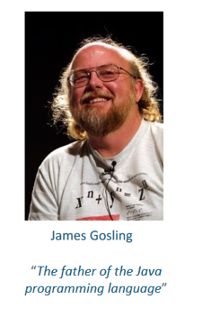
Scala – James Gosling
“If I were to pick a language to use today other than Java ,It would be Scala.

Slide 6
Basic Operations of Scala
Works on REPL Shell : Read – Evaluate – Print - Loop
Easiest way to get started with Scala ,acts as an interactive shell interpreter.

Slide 7
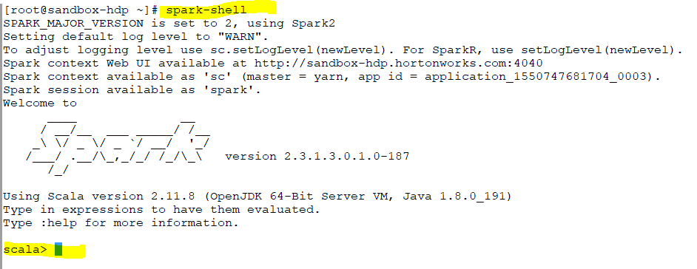

Slide 8

Scala :REPL Shell
After you type an expression ,such as 10 +2 ,and hit enter :
Scala> 10 + 2
The interpreter will print :
Res0: Int = 12
This line includes :
An automatically generated or User-defined name to refer to the computed value (res0,which means result 0) ,
A colon (:) , followed by the type of the expression (Int)
An Equals sign (=) ,The values resulting from evaluating the expression (12)

Slide 9
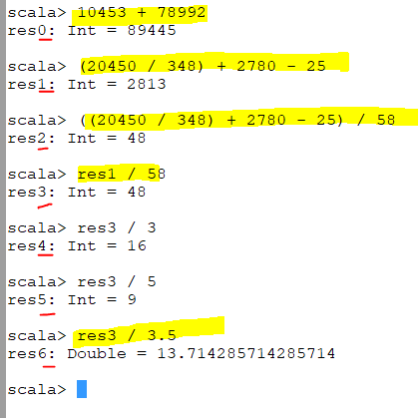
Int / int = int
Int / float = double

Slide 10
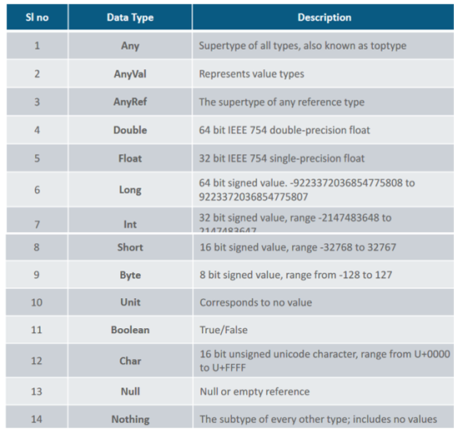
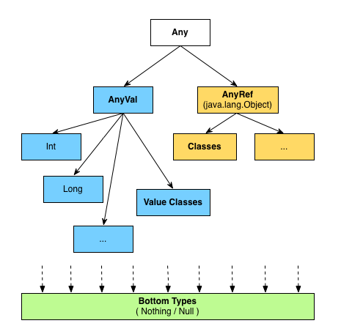
Data Types Available in Scala
Any data type in Scala is a class because they have functionality with it.

Slide 11
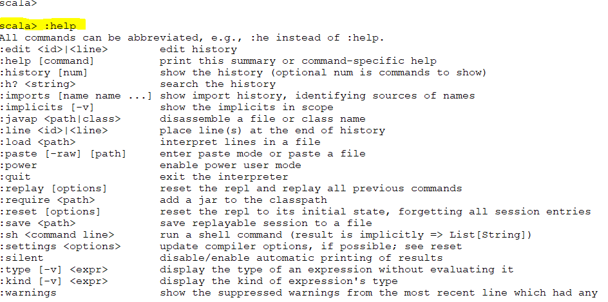

Slide 12
What is Variable ?
Variables are reserved memory locations for storing values
Types
Mutable
Immutable

Slide 13
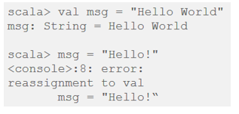
Variable Types ;Immutable
Immutable –val (Read only)
Once initialized ,value can not be reassigned

Slide 14
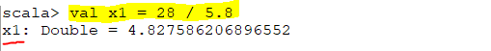
Every variable has to have an initialize value
You can not reassign a val variable
95% are val

Slide 15
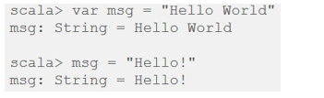
Variable Types :Mutable
Mutable –”var” (Read Write)
It allows to change the value after declaration of variable

Slide 16
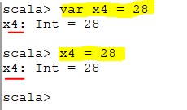

Slide 17
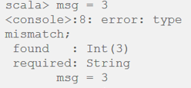
Type Inference
Even though we never declared variable type ,Scala inferred it ! This is called as Type Inference in Scala
Once a type is assigned to a variable ,It remains same for entire scope
Thus ,Scala is statically Typed language

Slide 18

Assigning Block Expression
In Scala ,a {} block is a list of expressions ,and result is also an expression
The value of a block is the value of the last expression of it.

Slide 19
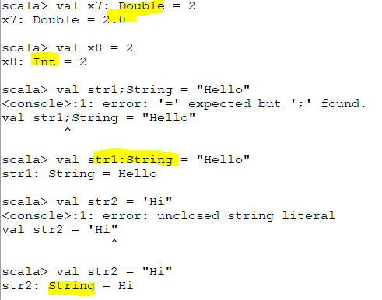
Not mandatory
mandatory
If we do not specify any data type ,Scala will evaluate the assignment of that data
Notes:
Is it mandatory to assign a value at the beginning ? Yes
Is it mandatory to define the type of a variable ? No

Slide 20
Lazy Value
Sometimes you may wish to delay the initialization of some variable until the point where it is consumed by your application .In such cases you can define a value as lazy in Scala.
In lazy evaluation ,The expression is not evaluated immediately ,but once on first access.
No evaluation occurs on subsequent access ,instead the stored result is returned immediately
Notes:
Advantages:
=========
Provides performance enhancement by not doing calculations until needed
Increase the response time of applications by postponing the heavy operations until required.

Slide 21
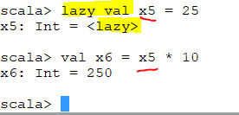
Notes:
Initialize it when its evaluated
In Scala we have If … else block .There is a one variable which is computation intense which require lots of resources and its in else block .
It may not be completed if we do not need it.
It evaluated it when the lazy variable is used somewhere .It will not initialized till it is used somewhere
X5 has not evaluated yet. X5 will be evaluated when we use it.
Scala is a functional programming language and may not be completed if it never is used.

Slide 22
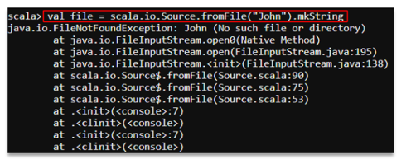

Example
If you want to read a file John ,if the file is not existing or present ,you will get FileNotFoundException exception
But if you initialize the value as Lazy ,you will not get an error ,because it will delay the initialization till it accesses the file John.
Notes:
Lazy Values do not give an error on initialization ,whereas no lazy value do give errors.

Slide 23
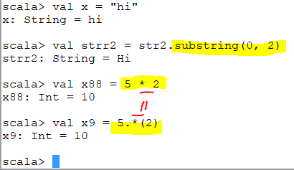
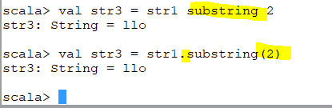
Operators
Scala does not give us ++ or --
Operators are functions
* Is a function

Slide 24
Wrapper Classes
StringOps
RichShort
RichByte
RichInt
RichLong
RichFloat
RichDouble
RichChar
RichBoolean
Provide utility methods on the specific data type
Notes:
Scaladoc: http://lampwww.epfl.ch/~hmiller/scaladoc/library/#package

Slide 25
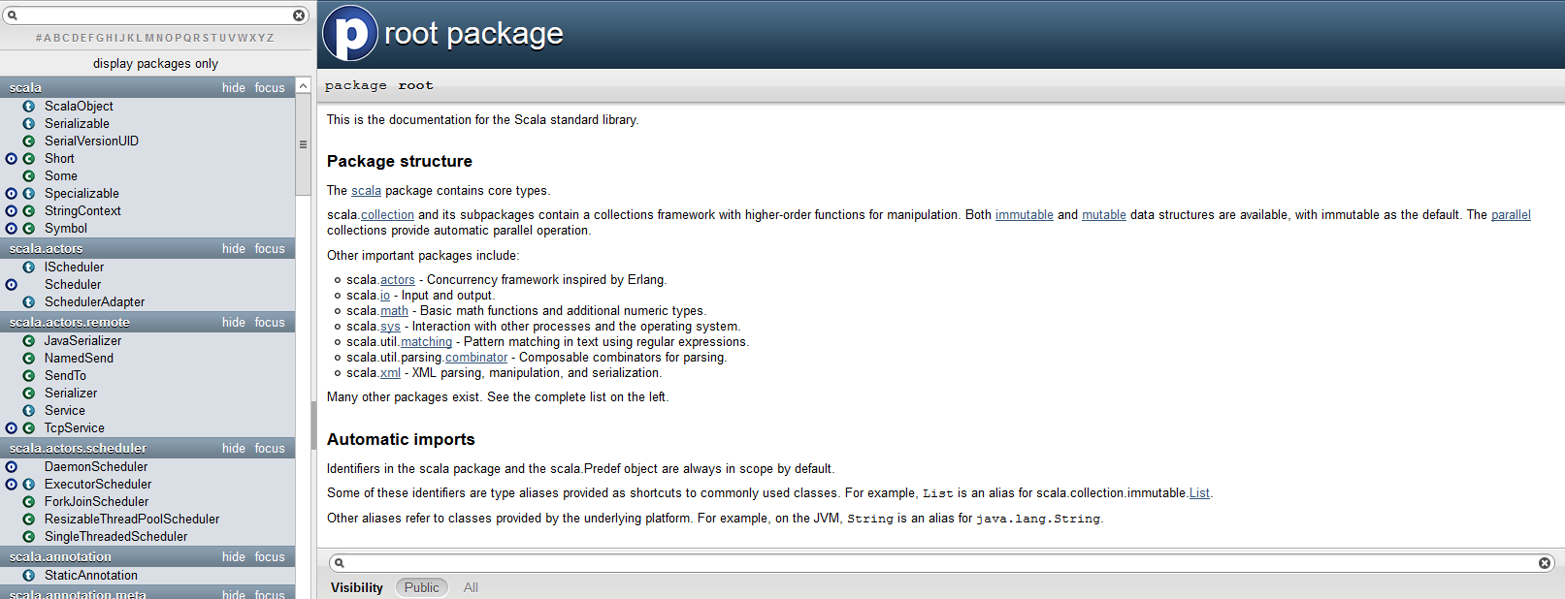
Wrapper Classes -utility methods
http://lampwww.epfl.ch/~hmiller/scaladoc/library/#package
It will give us lots of utility methods on top of these classes

Slide 26
Operators
+, -, *, /
Bit wise operators
All other operators are present in Java
() is also an operator; it is actually the apply() method
++ or -- operators are not present in Scala
In Scala, all operators are actually methods.

Slide 27
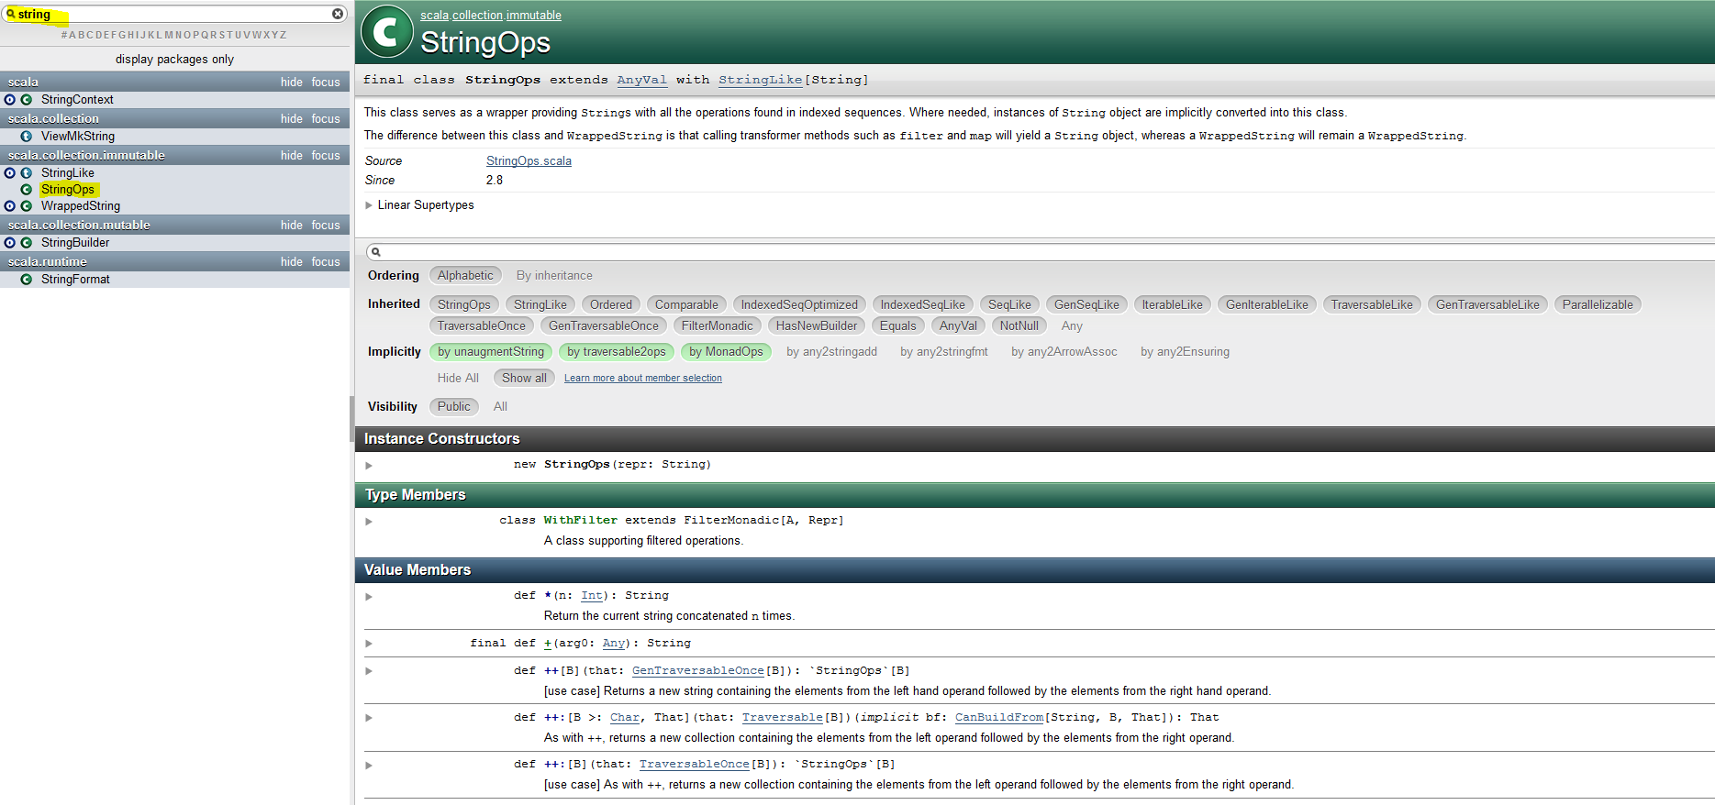

Slide 28
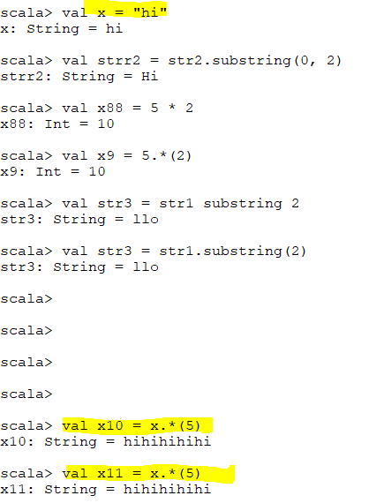

It will try to find a function in variable type itself .If it can not find the variable type ,it will convert these string variable to its wrapper types so it will covert it to string Ops subject then apply *

Slide 29
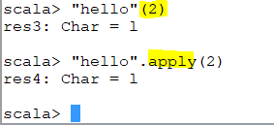
Apply
( ) is short form of apply .It does not indexing .It will find the character on that index

Slide 30
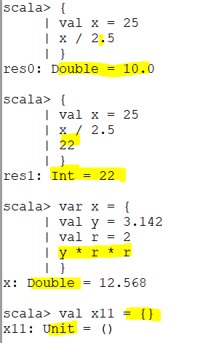
If its specify empty bracket it means unit .
The last statement of the block will be evaluated for whole block.

Slide 31
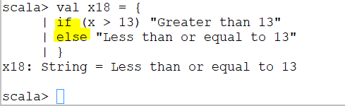
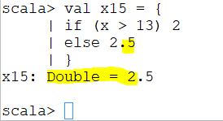
How Control Structures Work In Scala ? If Statement
If statement consists of Boolean expression followed by one or more statement.
Syntax :
if (Boolean_expression) {
// Statements will execute if the Boolean expression is true.

Slide 32
If-else statement
The if-else statement is a programming construct for choosing a branch of code based on whether an expression resolves to true or false.
Syntax :
If (Boolean expression) <expression>
Else <expression>

Slide 33
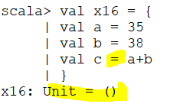
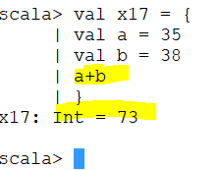
If the last statement of a block is assignment operation so the value is unit and hence the returns type is unit

Slide 34
Loops
while and do-while loops work exactly as that in Java and have the exact syntax
for loops have the following syntax:
for (i <- 1 to 5) { println(i) }
val str = “Hello”; for (i <- 0 to str.length - 1) { print(str(i)) }
val str = “Hello”; for (i <- str) { println(i) }
In the above example, “ i <- 1 to 5” is a generator; so is “i <- 0 to str.length - 1” and “i <- str”
Each generator generates a Range or a Sequence on which the loop iterates

Slide 35
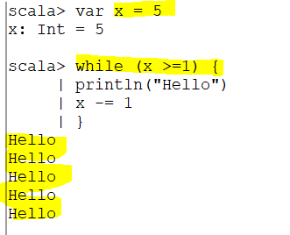
While
Notes:
While and do while

Slide 36
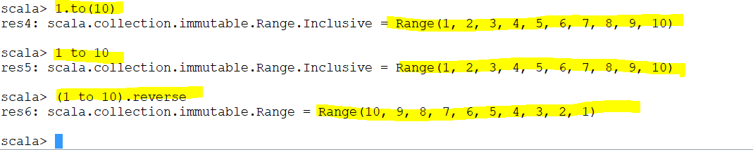
Since function can be written as this 1 to 10 so the result will be same

Slide 37
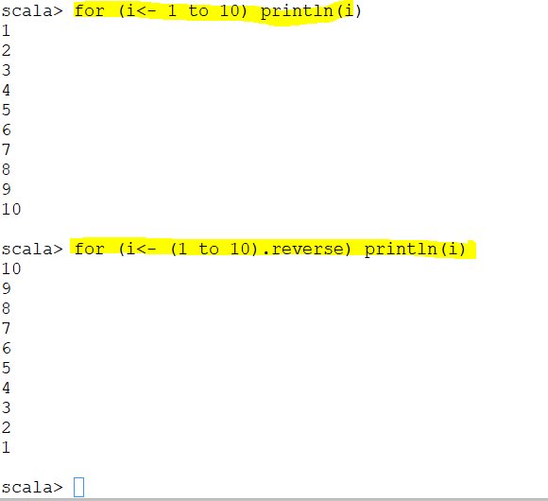
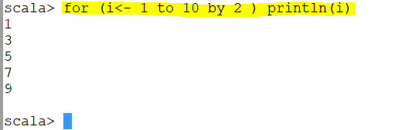
Notes:
Since function can be written as this 1 to 10 so the result will be same

Slide 38
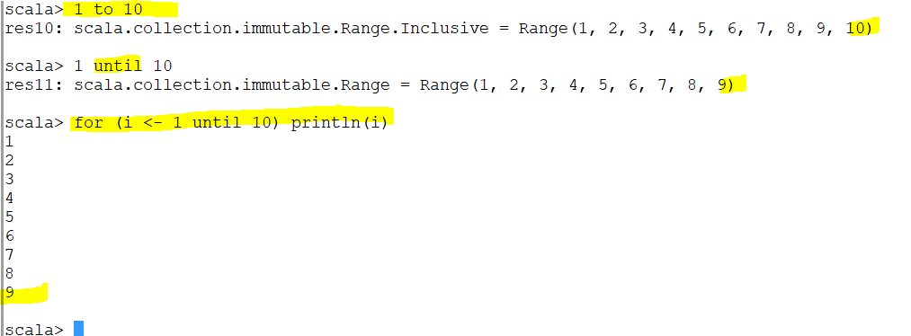

Slide 39
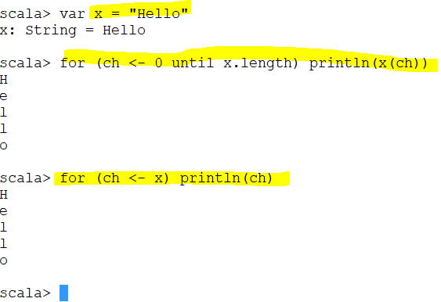
Scala has another way of doing it
Notes:
It takes each character from x which is the string and assign it to “ch” variable then ch become a character variable (of type character)

Slide 40
Advanced for Loops
Nesting can be done in the same loop statement:
for (i <- 1 to 5; j <- i to 5)
print(i * j)
Any number of definitions can be contained inside the for statement:
for (i < 1 to 5; j <- 1 to 2; product = i * j)
print(“Percentage: “ + (product / 100))
Each generator can have a “guard”:
for (i <- 1 to 10; j < 1 to 2 if i != j)
print(…)

Slide 41
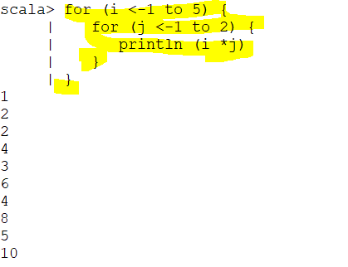
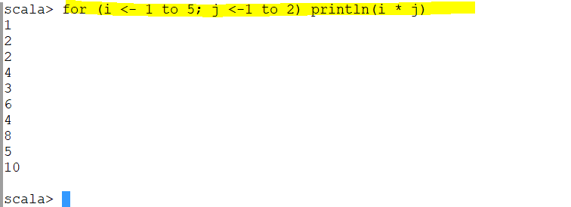
Traditional
Scala has better way of doing it
Notes:
I =1 j=1 and j=2
i=2 j=1 and j=2
….
Traditional

Slide 42
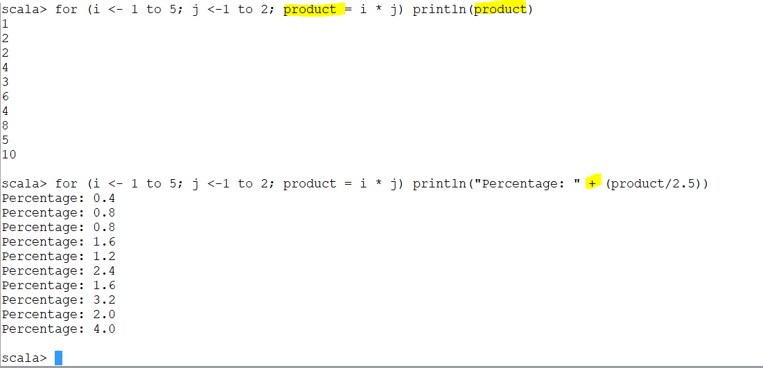
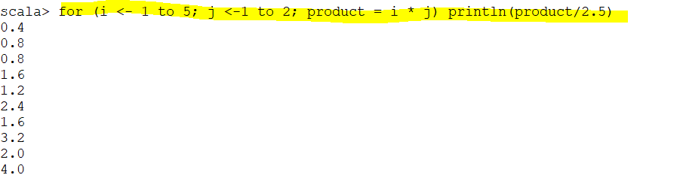
concatenate
Notes:
Within println we can concatenate two expression to form one single expression
Dynamic value is product/2.5

Slide 43
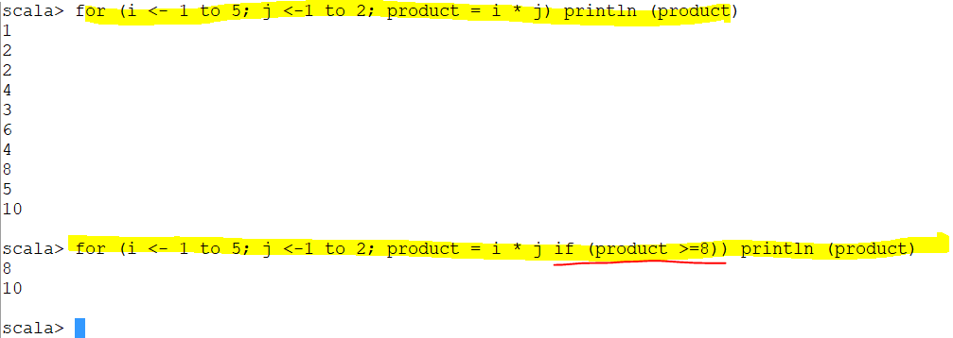
Guard
Guard is condition which you apply in for condition

Slide 44
for Comprehension
Uses the yield keyword:
for (i <- 1 to 10)
yield i / 2
Output: The above yields a Vector of type Int
The output type of the yield is compatible with the first generator in case of multiple generators:
for (ch <- “Welcome”; i <- 0 to 6)
yield ch + i
If I want all the individual values are combined the use yield

Slide 45
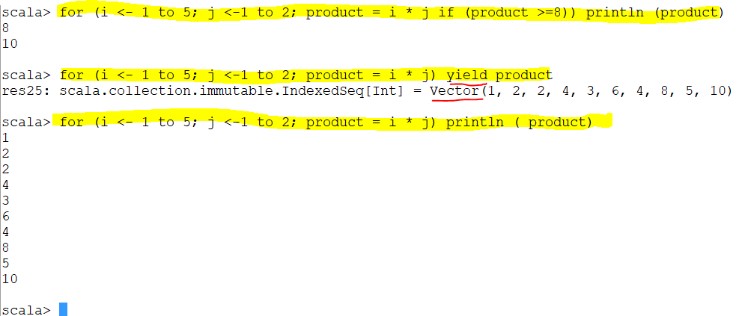
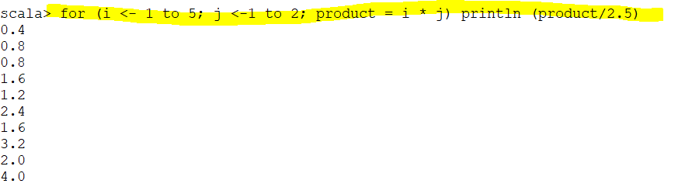
If you want to do something on individual value by for loop I use the normal thing .
If I want all the individual values are combined the use yield

Slide 46
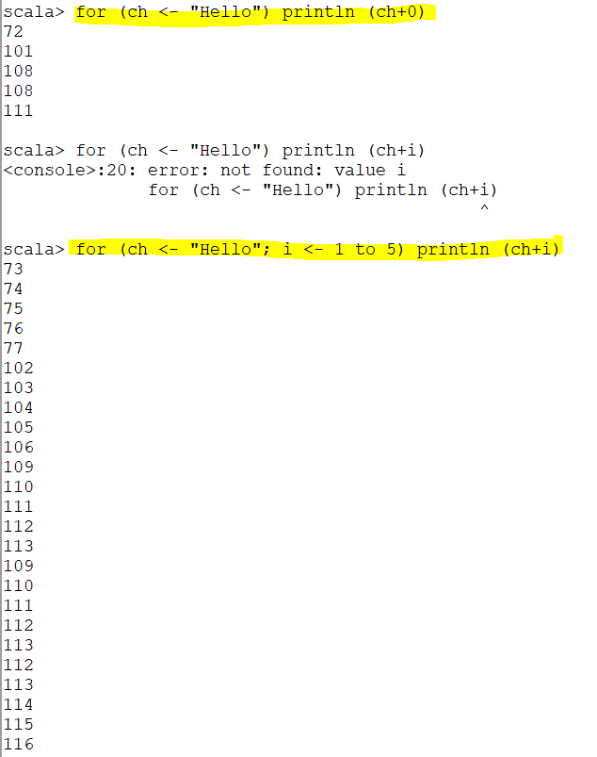
ASCCI value
Notes:
It will print the ASCCI value of H which is 72
Then it It will print the ASCCI value of e which is 101 and so on
========================================
Second code:
It will print the ASCCI value of H which is 72 + i(=1)
It will print the ASCCI value of H which is 72 + i(=2)
……..
It will print the ASCCI value of H which is 72 + I (=5)
So that’s why it becomes
73
74
75
76
77
Then go to o and so on

Slide 47
If the expression of yield has two different data type then the output will have the output of the first generator

Slide 48
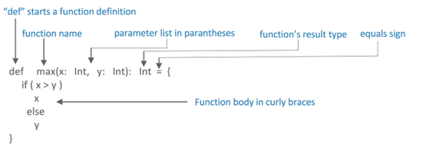
Functions
Scala has both functions and methods
A function in Scala is a complete object which can be assigned to a variable
Scala function’s name can have characters like +,++ ,~,&,-,--,\,/,:,etc

Slide 49
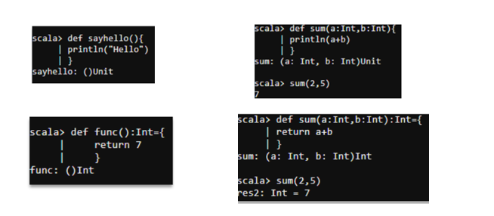
Function Declaration
Without Parameters With Parameters

Slide 50

Function :Recursion
Recursion means a function can call itself repeatedly
Scala supports recursion functions
We need to specify the datatype for a recursive function
5*4*3*2*1
Notes:
5*4*3*2*1

Slide 51
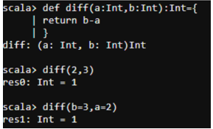
Argument to Function
Scala uses default values of function parameters when you forget to pass value during function call
While passing arguments to a function in a different order ,we can pass them with names:

Slide 52
Functions
def sum(x: Int, y: Int) = x + y
def palindrome(str: String) = {
str.reverse.equals(str)
}

Slide 53
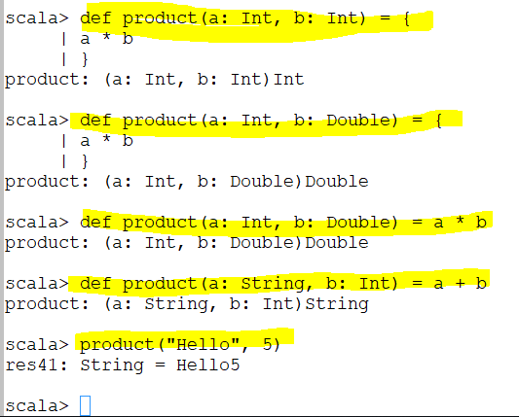

Slide 54
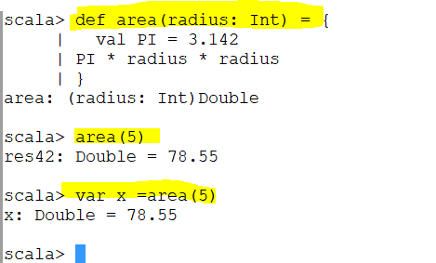
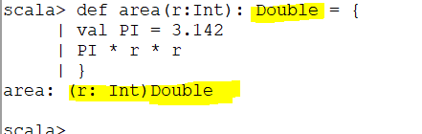
You can have multiple line in the function
You can assign the result to a variable too (x)
My own return type

Slide 55
Procedures
A procedure is a function that does not return a value
def showReverse(str: String) {
print(str.reverse)
}

Slide 56
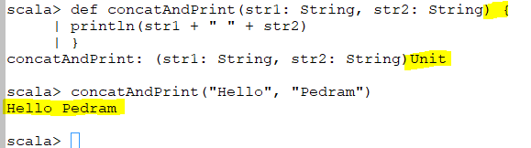
there is no “=“ sign

Slide 57
Named & Default Arguments
Function definition:
def sayHello(name: String; prefix: String = “Hello “; postfix: String = “!”) = {
prefix + name + postfix
}
Invocation: sayHello(“Rahul”) Output: “Hello Rahul!”
Invocation: sayHello(“Rahul”, “Welcome “, “.”) Output: “Welcome Rahul.”
Invocation: sayHello(“Rahul”, “Welcome “) Output: “Welcome Rahul!”

Slide 58
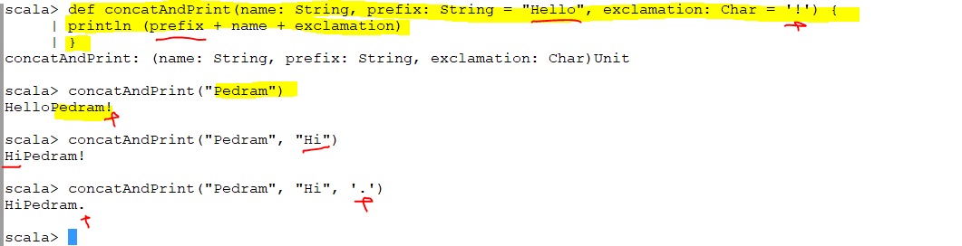
Notes:
Order is very important

Slide 59
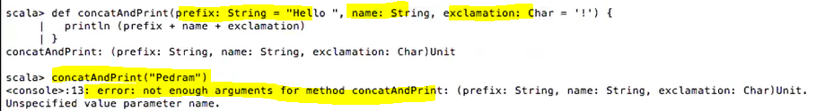
Order is very important when I do not name it
Argument are matched and sequences are also matched.

Slide 60
Named Argument
I am invoking my procedure by naming the argument. Which value belongs to which argument. In this case the order is not important

Slide 61
Variable Arguments
def avg(args: Int*) = {
var sum = 0
for (arg <- args)
sum += arg
sum / args.length
}
The function actually expects a Sequence

Slide 62
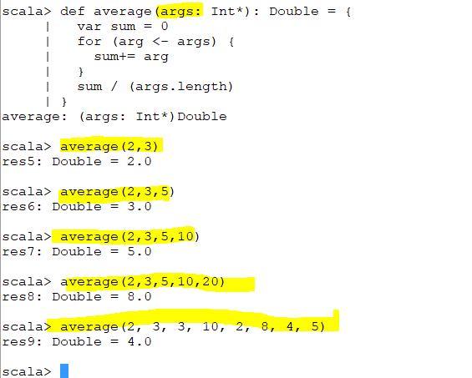
Notes:
Variable number of arguments

Slide 63
Arrays
Using the new operator:
val arr = new Array[Int](5)
Initialized with zeros
var arr = new Array[String](5)
Initialized with nulls
val arr = new Array[Double](5)
Initialized with 0.0
Using Array initializer:
val arr = Array(1, 5, 8, 5, 8)
val arr = Array(“Hello”, “Hi”)
Access elements:
arr(n)
Array is a class
Notes:
Internally, Scala arrays are converted into a Java array of the corresponding type

Slide 64

Default data type for Int is 0 for Double is 0.0 for String is null

Slide 65


Slide 66
Variable Length Arrays – Array Buffers
Using the new operator:
val arrBuffer = new ArrayBuffer[Int]()
Creates an empty ArrayBuffer object
val arrBuffer = new ArrayBuffer[Int]
Creates an empty ArrayBuffer object
Add single/multiple elements to the ArrayBuffer:
arrBuffer += 4
arrBuffer += (8, 5, 2, 8)
Add an entire Array/ArrayBuffer to the ArrayBuffer:
arrBuffer ++= Array(1, 2, 5, 8)
Remove single/multiple elements from an ArrayBuffer:
arrBuffer -= 1
arrBuffer -= (1, 2, 5, 8)
Remove an entire Array/ArrayBuffer from the ArrayBuffer
arrBuffer --= Array(1, 2, 5, 3)
Notes:
There are numerous more methods to add/remove elements from an ArrayBuffer. Please refer to the Scaladoc for a complete list of such methods.

Slide 67



Slide 68


Slide 69



Slide 70
Variable Length Arrays - ArrayBuffers
Adding single/multiple elements at random location:
arrBuffer.insert(1, 8)
Adds the element 8 at index 1. All current elements starting at index 1 are shifted to the right.
arrBuffer.insert(1, 2, 8, 9)
Adds the elements (2, 8, 9) at index 1. All current elements starting at index 1 are shifted to the right.
Removing single/multiple elements starting at random location:
arrBuffer.remove(2)
Removes the element at index 2
arrBuffer.remove(2, 4)
Removes 4 elements starting at index 2

Slide 71


Slide 72

Traverse an Array/ArrayBuffer
Traverse individual elements:
for (elem <- arr) println(elem)
Traverse using an index:
for (i <- 0 until arr.length) println(arr(i))
Traverse alternate elements:
for (i <- 0 until arr.length by 2) println(arr(i))
This prints all elements at locations 0, 2, 4…
To "traverse the array" is simply to go through each element in turn.

Slide 73
Common Functions
arr.sum
arr.contains
arr.count
arr.sorted
arr.sortWith
arr.mkString

Slide 74

Notes:
Prefix ,separator ,sufix

Slide 75
Variable Length Arrays - ArrayBuffers
Converting an ArrayBuffer to an Array:
arrBuffer.toArray
Converting an Array to an ArrayBuffer:
arr.toBuffer

Slide 76



Slide 77
Multidimensional Arrays
Create a multi-dimensional array:
val multiDimArr = Array.ofDim[Int](4, 3)
Access an element at a specific location:
val elem = multiDimArr(1)(0)
Set the element at the specific location:
multiDimArr(1)(0) = 8
Create a variable length array:
val varLengthArr = new Array[Array[Int]](10)
This creates a multi-dimensional array i.e. an array of 10 arrays where the length of each inner array is yet to be decided

Slide 78

Create a Fixed length array
Create a variable length array

Slide 79
Maps
Immutable maps:
val departments = Map(1 -> “admin”, 2 -> “HR”, 3 -> “finance”)
Mutable maps
import scala.collection.mutable.Map
var departments = Map(1 -> “admin”, 2 -> “HR”, 3 -> “finance”)
Accessing an element of a Map:
val departmentName = departments(1)
This will return “admin”
val departments = getOrElse(4, “learning & development”)
This will return a default value “learning & development” in case the given key is not present in the Map
Setting values in a mutable Map:
departments(1) = “operations”
Demonstrating Maps as a group of tuples:
val departments = Map((1, “admin”), (2, “HR”), (3, “finance”))

Slide 80


Slide 81

scala Map.getOrElse - how to provide function for default

Slide 82


Slide 83
Maps
Add entries to a Map:
departments += (4 -> “operations”, 5 -> “procrurement”)
Remove an entry from a Map:
departments -= 3
This will remove the entry with the key equal to 3
Iterating through Maps:
for ((k, v) -> departments) println(“Key: “ + k + “, Value: “ + v)

Slide 84


Slide 85


Give me a tuple for each key value in the map .In the map all entries are tuples

Slide 86
Sorted Map & LinkedHashMap
SortedMap:
import scala.collection.mutable.SortedMap
val sortedMap = SortedMap(10 -> “admin”, 8 -> “operations”, 15 -> “HR”, 6 -> “procrurement”)
The Map entries would be sorted based on the keys
LinkedHashMap:
import scala.collection.mutable.LinkedHashMap
val linkedHashMap = LinkedHashMap(1 -> “Sunday”, 2 -> “Monday”, 3 -> “Tuesday”, 4 -> “Wednesday”, 5 -> “Thursday”, 6 -> “Friday”, 7 -> “Saturday”)
This would create a Map that retains the insertion order of elements

Slide 87


The Map entries would be sorted based on the keys
This would create a Map that retains the insertion order of elements
Notes:
Why the map is not maintaining the insertion order ? To be able to maintain it we have to use linked hash map

Slide 88

Tuples
Tuples are groups of values that can be of disparate types
2-tuple:
val t = (1, “Welcome”)
3-tuple:
val t = (1, 5.47, “Hi”)
n-tuple:
val t = (1, 5.47, “Hi”, 3.42, 8.78, 4, ‘c’, “Welcome”, …upto n)
Access a specific value in a tuple:
val firstElement = t._1 or t _1
val secondElement = t._2 or t _2

